Slide 1
PBL DEMONSTRATION
Members
Vaishnavi Shete
Shikha Shaj
Vignesh Panikar
Sidhharth Dalvi

Slide 2
Problem Statement
To Develop a Certificate Generator System Using Java

Slide 3
Introduction
Java is a programming language created by James Gosling from Sun Microsystems (Sun) in 1991. The target of Java is to write a program once and then run this program on multiple operating systems.
Our certificate generator system is able to generate certificate for events held in PCE such as ALEGRIA,PBL,CSI-WORKSHOP etc.

Slide 4
JAVA
Java is an object-oriented programming language with its runtime environment. It is a combination of features of C and C++ with some essential additional concepts. Java is well suited for both standalone and web application development and is designed to provide solutions to most of the problems faced by users of the internet era.
Java provides GUI development through various means like Abstract Windowing Toolkit (AWT), Swing and JavaFX.
Java can be used to create complete applications that may run on a single computer or be distributed among servers and clients in a network.

Slide 5
SWING
Java Swing is a part of Java Foundation Classes (JFC) that is used to create window-based applications. It is built on the top of AWT(Abstract Windowing Toolkit).API and entirely written in java.
Unlike AWT, Java Swing provides platform-independent and lightweight components.
The javax.swing package provides classes for java swing API such as JButton, JTextField, JTextArea, JRadioButton, JCheckbox, JMenu, JColorChooser etc.

Slide 6
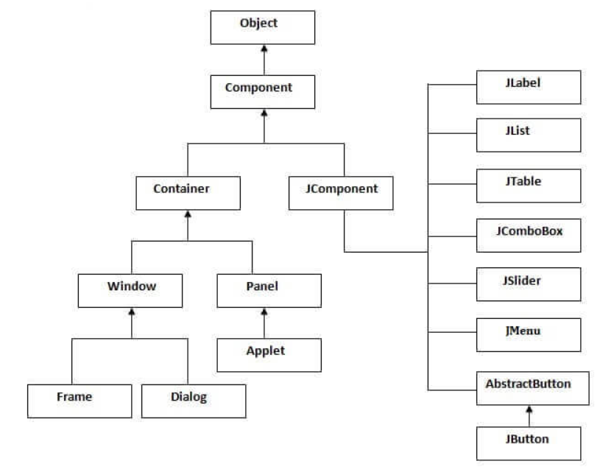
SWING CLASS

Slide 7
AWT
Java AWT (Abstract Window Toolkit) is an API to develop GUI or window-based applications in java.
Java AWT components are platform-dependent i.e. components are displayed according to the view of operating system. AWT is heavyweight i.e. its components are using the resources of OS.
The java.awt package provides classes for AWT api such as TextField, Label ,TextArea, RadioButton, CheckBox, Choice, List etc.

Slide 8
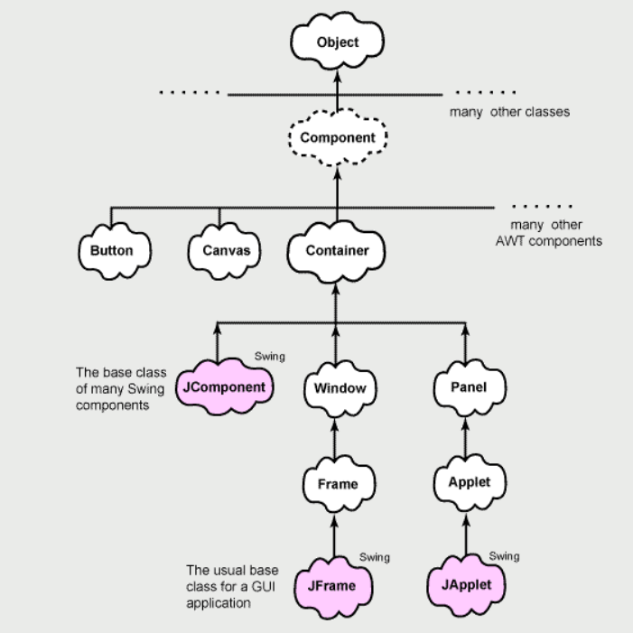
AWT - FLOWCHART

Slide 9
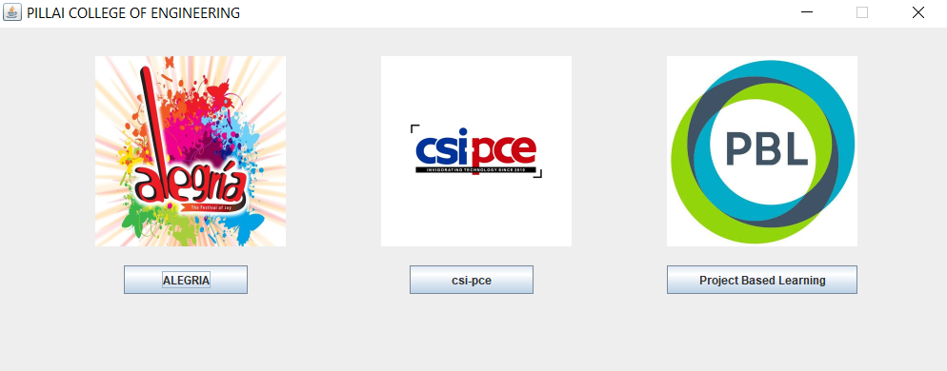
FRAME GENERATION
LOGIN FRAME

Slide 10
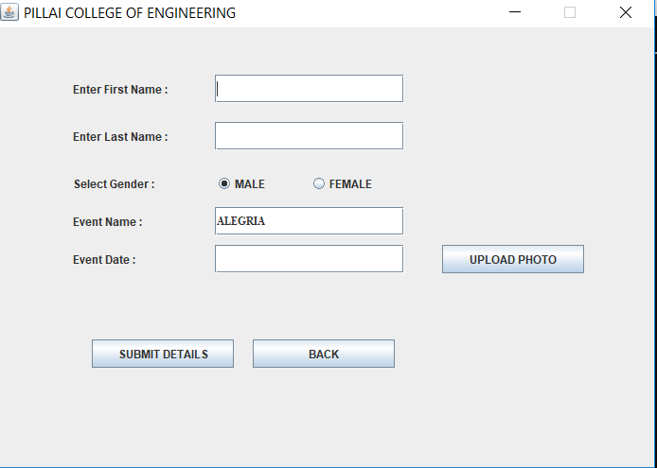
DETAIL FRAME

Slide 11
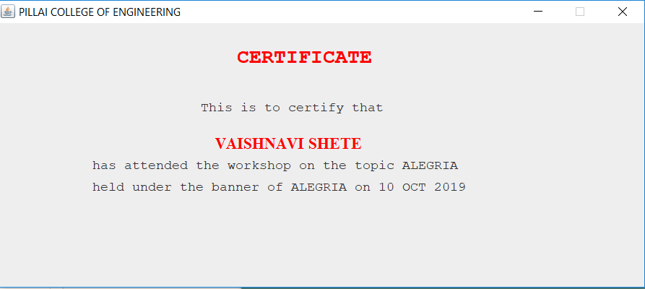
CERTIFICATE

Slide 12
CONCLUSION
Hence we conclude that by using java classes like Swing,Awt we can generate many application like Certificate Generator System.

